Slide 1

Chapter 2 Java Basic

Slide 2

Outline
1. Defining of Classes
2.Constructors(构造器)
3. The"this"Keyword
4. The"static"Keyword
5. Lifetimes of Variables（变量的生存期）
6. Primitive Types(基本类型)
7. Conditionals(条件语句)
8. Objects AND Methods
9. LOOPS（循环语句）

Slide 3

1. Defining Classes
Methods perform actions on the objects.
Fields are variables stored in objects. Fields are used to store data.
Difference between Fields and Methods?
Fields never have parameters, and no parentheses(圆括号) appear after them.

Slide 4
1. Defining Classes
A class definition for the Human class.
class Human{
// fields
public int age;//The Human’s age (an integer).
public String name;//The Human’s name.
// methods
public void introduce() {
System.out.println("I’m "+name+" and I’m "+age+" years old.");
}
}

Slide 5
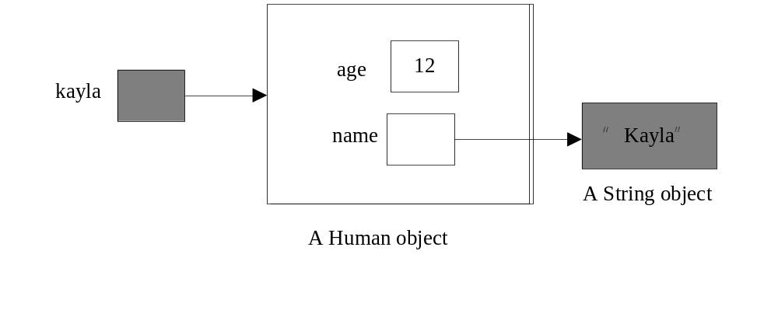
1. Defining Classes
Human kayla=new Human();//Create kayla.
kayla.age=12;//Set kayla’s fields.
kayla.name="Kayla";

Slide 6
1. Defining Classes
Question ：What’s the output?
kayla.introduce();//Have kayla introduce herself.
The output is:
I’m Kayla and I’m 12 years old.

Slide 7
1. Defining Classes
If we want to mix two or more objects, we can
class Human
{
//Include all the stuff from the previous definition of Human here.
// …
public void copy(Human original)
{
age=original.age;
name=original.name;
}
}
NOTE
在Java中，当前类可以接受和处理当前类的对象

Slide 8

2. Constructors(构造器)
Code to initialize a new object
class Human{
//Include all the stuff from the previous definitions here.
public Human(String givenName)// same name as class
{
age=12;
name=givenName;
}
}
What’s the return object of contructors?

Slide 9
2. Constructors
缺省控制器
If you write your own Human constructor, even if it takes parameters, the default (缺省的)constructor goes away. If you want to have the default constructor and another constructor, you must define both explicitly（显式）.
// no constructor
class C1{
}
// one constructor
class C2{
public C2(int k){}
}
C1 c1= new C1();// OK
C2 c2= new C2();// compile error
Notes:
cass F{
}

Slide 10
2. Constructors
Override the default constructor
class Human
{
//Include all the stuff from the previous definitions here.
public Human()
{
age=0;
name="Untitled";
}
}

Slide 11
3. The"this"Keyword
Use “this” in default constructor
class Human
{
//Include all the stuff from the previous definitions here.
public Human()
{
this.age=0;// age = 0 is also ok
this.name=“Untitled”;
}
}
反义词：
Compulsory
必选的
In this case, “this ” is optional(选填项).

Slide 12
3. The"this"Keyword
Use “this” in another method
public void change (int age)// have priority against fields
{
String name="Chang"; // name is a local variable
this.age=age;
this.name=name; // use “this” to refer to object’s fields
}
If the parameters or local variables of a method have the same name as the fields of an object, then the former have priority, and the "this“ keyword is needed to refer to the object’s fields.

Slide 13
3. The"this"Keyword
Execution of change() method
Before
Parameters & local variables of change()
kayla
age
12
age
8
this
name
Kayla
name
Chang
After
Parameters & local variables of change()
kayla
age
8
age
8
this
name
Kayla
name
Chang

Slide 14


3. The"this"Keyword
You CANNOT change the value of"this"!
Such as “this=kayla ”
What’s the result of this mistake?
A compile-time error.

Slide 15

4. The"static"Keyword
A static field is a single variable shared by a whole class of objects; its value does not vary from object to object.
How could we count the number of Human objects?
Object variables or static fields (class variables)?

Slide 16

4. The"static"Keyword
A good solution
class Human{
public static int numberOfHumans;
public int age;
public String name;
public Human(){
numberOfHumans++;//The constructor increments
//the number by one.
}
}
int kids=Human.numberOfHumans/4; //Good.
int kids=kayla.numberOfHumans/4; //This works too, but has nothing to
//do with kayla specifically.Don’t do this;it’s bad (confusing)style.

Slide 17
4. The"static"Keyword
Methods can be static too
class Human
{
...
public static void printHumans()
{
System.out.println(numberOfHumans);
}
}
In a static method, THERE IS NO "this"!

Slide 18
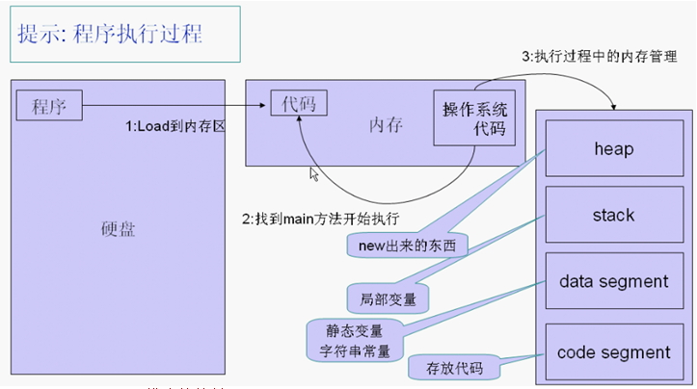
5. Lifetimes of Variables (变量)
-A local variable (declared in a method) is gone forever as soon as the method in which it’s declared finishes executing. (If it references an object, the object might continue to exist, though.)
-An instance variable (non-static field) lasts as long as the object exists.
-An object lasts as long as there’s a reference to it.
-A class variable (static field) lasts as long as the program runs.

Slide 19
6. PRIMITIVE TYPES
Not all variables are references to objects. Some variables are primitive types.
8-bit
Range
byte
-128…127
16-bit
short
…..
-32768…32767
32-bit
int
…..
-2147483648…2147483647
64-bit
long
…..
-9223372036854775808...9223372036854775807

Slide 20
6. PRIMITIVE TYPES
64-bit
Range
±1.79769313486231570E+308
(15 significant digits)
double
…..
32-bit
float
±3.40282347E+38
(6~7 significant digits)
…..
1-bit
boolean
true or false
16-bit
char
Unicode Character Set
…..

Slide 21
6. PRIMITIVE TYPES
Difference between Object types and Primitive types
 | Object types | Primitive types
Variable contains | a reference | value
How defined? | class definition | built into Java
How created? | "new" | "6", "3.4"，"true"
How initialized? | constructor default | (usually zero)
How used? | methods | operators ("+", "*", etc.)

Slide 22

6. PRIMITIVE TYPES
Operations on int, long, short, and byte types.
-x x * y
x + y x / y <-- rounds toward zero (drops the remainder).
x - y x % y <-- calculates the remainder of x / y.
Except for “%”, these operations are also available（适用于） for doubles and floats.

Slide 23
6. PRIMITIVE TYPES
More operations in java.lang library
- the Math class.
x = Math.abs(y); // Absolute value. Also see Math.sqrt, Math.sin, etc.
- the Integer class.
int x = Integer.parseInt("1984"); // Convert a string to a number.
- the Double class.
double d = Double.parseDouble("3.14");

Slide 24
6. PRIMITIVE TYPES
Converting types: integers can be assigned to variables of longer types.
int i = 43;
long k = 43L;
k = i; // Okay, because longs are a superset of ints.
i = k; // Compiler ERROR.
i = (int) k; // Okay.
The string “(int)” is called a cast(转换), and it casts the long into an int.
Integers can be directly assigned to floating-point variables,
but the reverse requires a cast.

Slide 25
7. CONDITIONALS
An “if” statement uses a boolean expression to decide whether to execute a set of statements. The forms are：
if (boolValue1)
{
statements1;
}
else if（ boolValue2）
{
statements2;
}
else
{
statements3；
}
if (boolValue)
{
statements;
}
Form 1
Form 1
Form 3
if (boolValue)
{
statements1;
}
else
{
statements2;
}
Form 2
Clauses can be nested（嵌套） and daisy-chained（多路选择）

Slide 26
8. OBJECTS AND METHODS
String s1;//Step 1:declare a String variable.
s1=new String();//Step 2:assign it a value:a new empty string.
String s2=new String();//Steps 1&2 combined.
We get…
s1
〝〞
s2
〝〞
s1="Yow!";//Construct a new String;make s1 a reference to it.
s2=s1;//Assign s2 the value of s1.
s1
Yow!
s2

Slide 27
8. OBJECTS AND METHODS
What if we want to have a copy of the object?
s2=new String(s1);//Construct a copy of s1;make s2 a reference to it.
s1
Yow!
s2
Yow!
They refer to two different, but identical, objects.

Slide 28

8. OBJECTS AND METHODS
-Java looks inside the variable s1 to see where it’s pointing.
-Java follows the pointer to the String object.
-Java reads at the characters stored in that String object.
-Java creates a new String object that stores a copy of those characters.
-Java makes s2 reference the new String object.
s2=new String(s1);//Construct a copy of s1;make s2 a reference to it.
s1
Yow!
s2
Yow!
What happened when Java executes that line?

Slide 29
8. OBJECTS AND METHODS
Three String constructors:
(1)new String()
constructs an empty string，it’s a string,
but it contains no characters.
(2)"cs 4"
constructs a string containing the characters " cs 4 ".
(3) new String(s1)
takes a parameter s1. Then it makes a copy of
the object that s1 references.

Slide 30

8. OBJECTS AND METHODS
Some other methods of String
s2=s1.toUppercase();//Create a string like s1, but in all upper case.
String s3=s2.concat ("!!");//Also written:s3=s2+"!!";
String s4="*".concat (s2).concat ("*");//Also written:s4="*"+s1+"*";
s1
Yow!
s2
YOW!
s3
YOW!!!
s4
*YOW!*
An important fact:
When Java executed the line s2=s1.toUppercase();
the String object "Yow!“ did not change. Instead, s2 itself changed to reference a new object.

Slide 31
8. OBJECTS AND METHODS
Strings are immutable（无法更改）
Once they’ve been constructed, their contents（内容） never change. If you want to change a String object, you’ve got to create a brand new String object that reflects the changes you want.
This is not true for all objects in Java
Most Java objects let you change their contents.

Slide 32
9.LOOPs（循环语句）
Like an"if"statement, but the body of the statement is executed repeatedly, as long as the condition remains true.
“while”
A convenient shorthand that can be used to write some"while" loops in a more compact way.
“for”
Has just one difference from a"while"loop.If Java reaches a"do"loop, it_always_executes the loop body at least once.
“do”
A"break"statement immediately exits the innermost loop or"switch"statement enclosing the"break", and continues execution at the code following the loop or"switch".
“break”
It only applies to loops;
It doesn’t exit the loop; it jumps past the end of the loop body, but it’s still inside the loop.
“continue”

Slide 33
Assignment
Homework:
每周抄写不少于20个专业相关的单词，要求有例句，音标，无重复。每周一学委收齐后上交，算平时成绩。

Slide 34
The End

